Slide 1
Introduction to Software Engineering
Introduction
Muhammad Nasir
m.nasir@iiu.edu.pk

Slide 2
Outline
What is software
What is Engineering
What is Software Engineering
Hardware vs. Software
Software characteristics
Types of software

Slide 3
What is Software ?
Software is a set of instructions that directs a computer's processor to perform specific operation(s)

Slide 4
What is Software ?
Types of Software
  Generic - developed to be sold to a range of different customers e.g. Application software such as MS Excel or Word.
  Bespoke (custom) - developed for a single customer according to their specification

Slide 5
What is Engineering
Engineering is the application of scientific, economic, social, and practical knowledge in order to design, build, and maintain structures, machines, devices, systems, materials and processes.
Notes:
Science: “The intellectual and practical activity encompassing the systematic study of the structure and behavior of the physical and natural world through observation and experiment”

Slide 6
What is software engineering?
Definition by IEEE :
(1) The application of systematic, disciplined, quantifiable approach to the development, operation, and maintenance of software; that is, the application of engineering to software.
(2) The study of approaches as in (1) above
“Its a discipline that is concerned with all aspects of software production”. Ian Sommerville

Slide 7
Hardware vs. Software
Hardware | Software
Manufactured Wear out Built using components Relatively simple | Developed/ Engineered Obsolete Custom built Complex

Slide 8
Manufacturing vs. Development
Once a hardware product has been manufactured, it is difficult or impossible to modify.
In contrast, software products are routinely modified and upgraded.

Slide 9
Manufacturing vs. Development
In hardware, hiring more people allows you to accomplish more work, but the same does not necessarily hold true in software engineering.
Unlike hardware, software costs are concentrated in design rather than production.

Slide 10
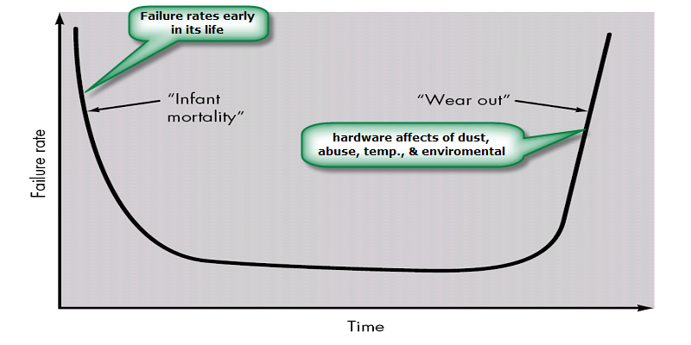
Failure Curve for Hardware

Slide 11
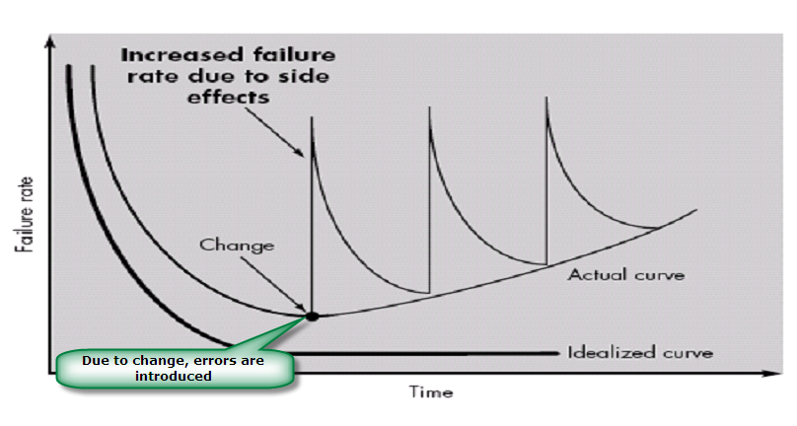
Failure curve for Software

Slide 12
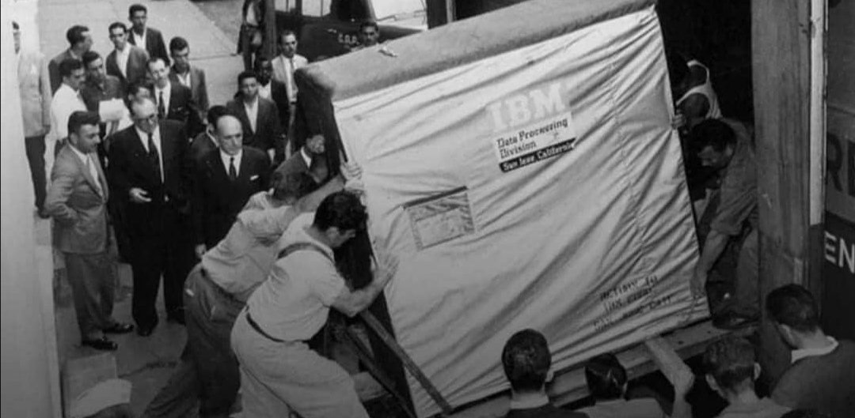
1956 – 5 MB Hard Drive

Slide 13
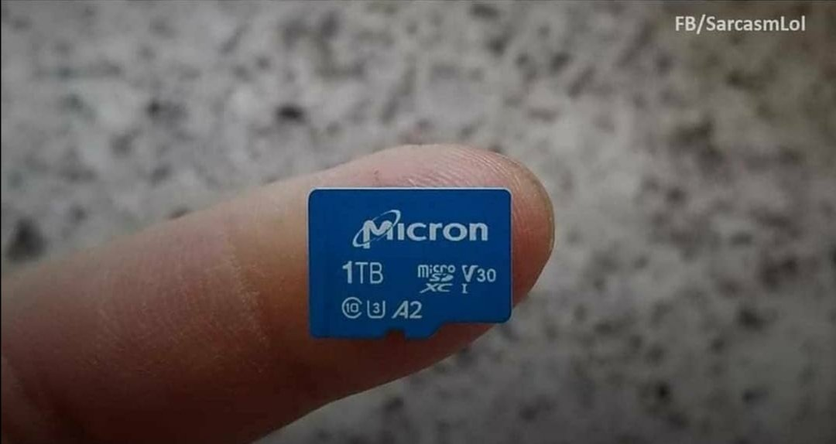
Modern Memory

Slide 14
Failure curve for Software
When a hardware component wears out, it is replaced by a spare part
There are no software spare parts
Every software failure indicates an error in design or in the process through which design was translated into machine executable code
Therefore, software maintenance involves considerably more complexity

Slide 15
Component Based vs. Custom Built
Hardware products typically employ many standardized design components.
Most software continues to be custom built.
The software industry has also moving towards component-based construction.

Slide 16
Characteristics of Software
Software is developed or engineered; it is not manufactured.
Software does not “wear out” but it becomes Obsolete.
Software continues to be custom built, as industry is moving toward component based construction.

Slide 17
Types of Software
System software
Application software
Engineering/scientific software
Embedded software
Web applications
Artificial intelligence software

Slide 18
The End
Thanks For Listening

